Slide 1
Algorithm Development: Numerical Methods in MATLAB
GROUP 13

Slide 2
Brief overview of numerical methods for root finding and ODE solving
Numerical methods are essential tools in mathematics and engineering for approximating solutions to problems that cannot be solved analytically. They are particularly useful for root finding and solving ordinary differential equations (ODEs). Numerical Methods for Root Finding algorithms are designed to find the values of x for which a continuous function f(x) equals zero, i.e., f(x)=0. These values are called the "roots" or "zeros" of the function. Most numerical root-finding methods are iterative, meaning they generate a sequence of increasingly accurate approximations to the root, starting from one or more initial guesses

Slide 3
Importance of algorithm design, control structures in MATLAB.
Algorithms provide a step-by-step approach to solving engineering problems systematically.
Algorithms help manage tolerance levels, convergence checks, and error minimization.

Slide 4
When generating the codes, we followed the specific steps for it to run;
1. Define the Problem
2. Choose the Appropriate Numerical Method
3. Set Up the MATLAB Code
4. Provide Necessary Inputs
5. Execute and Analyse Results
6. Validate and Refine

Slide 5
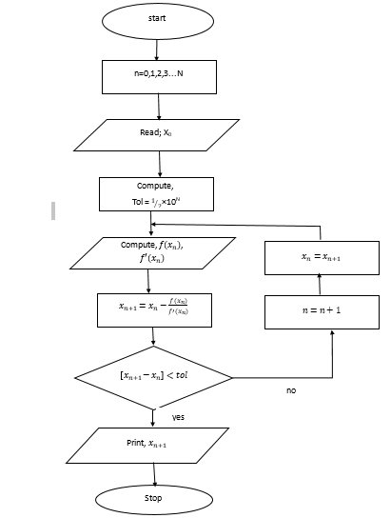
Newton Raphson method
For this method, the flow chart attached was derived and it helped us come up with the codes

Slide 6
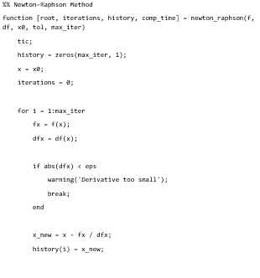
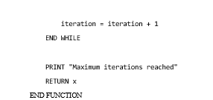
Pseudo code

Slide 7
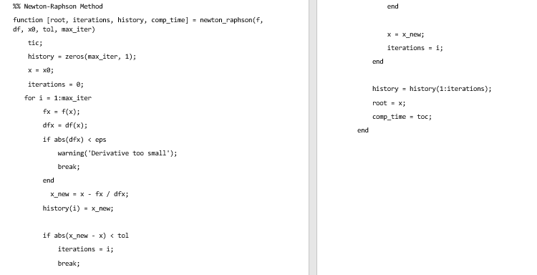
Matlab codes

Slide 8
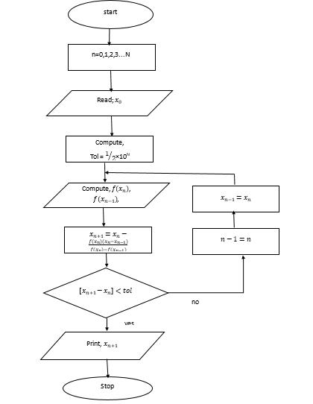
Secant method

Slide 9
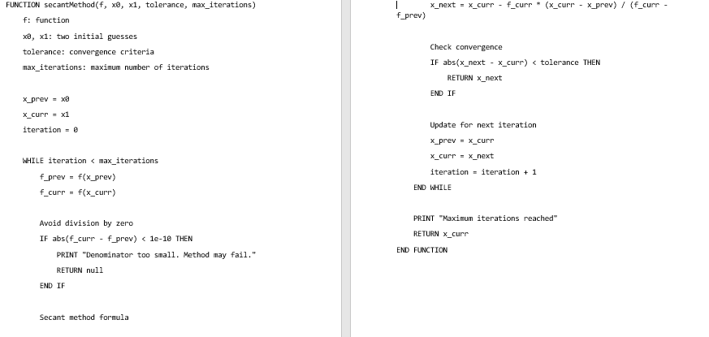
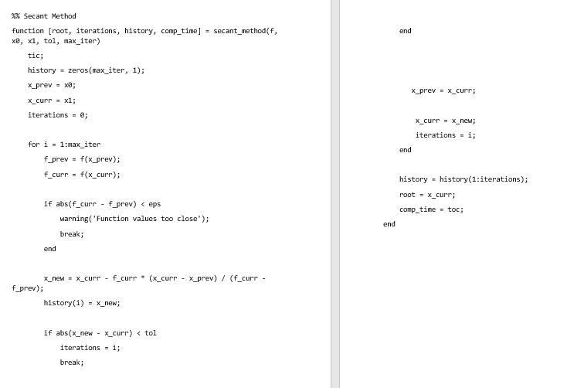
Pseudo codes and matlab

Slide 10
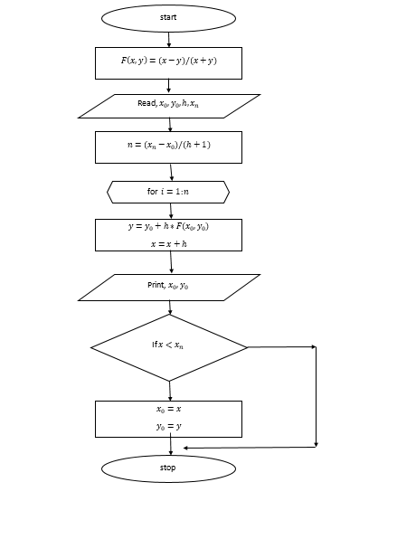
euler’s method

Slide 11
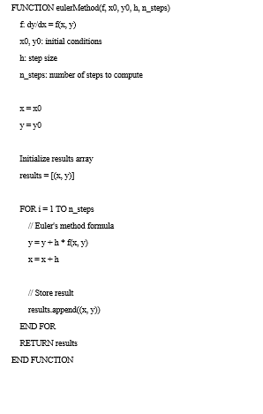
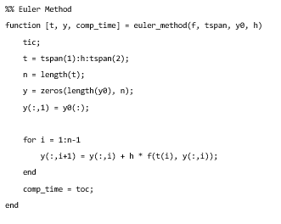
Psuedo and matlab codes
Psuedo codes
Matlab codes
Notes:
s

Slide 12
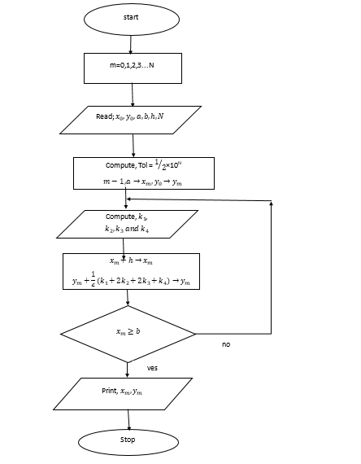
Runge kutta

Slide 13
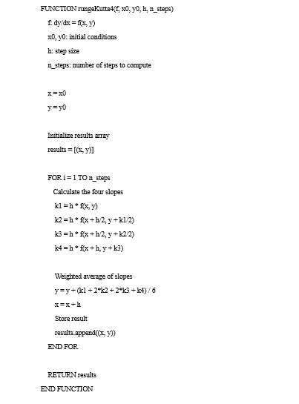
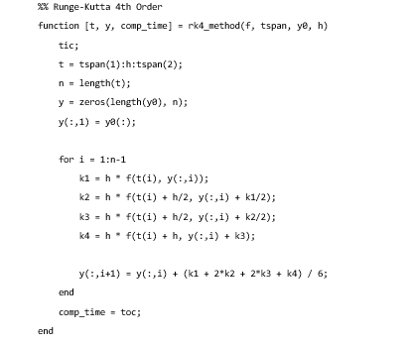
Pseudo and matlab codes

Slide 14
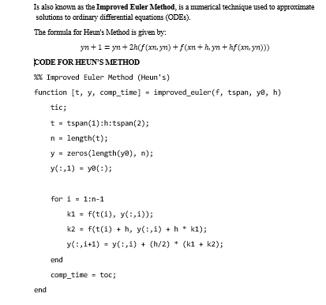
Huens method

Slide 15
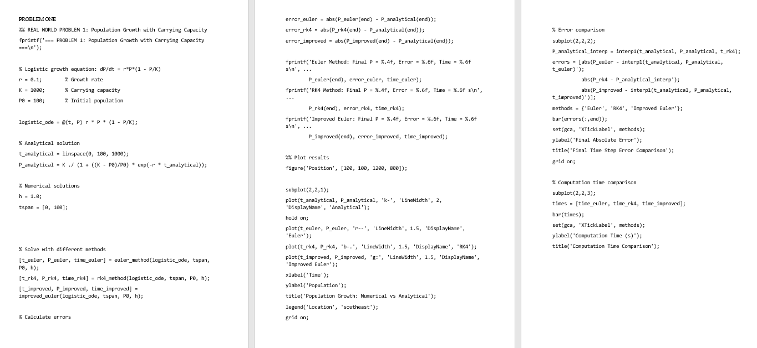

Slide 16
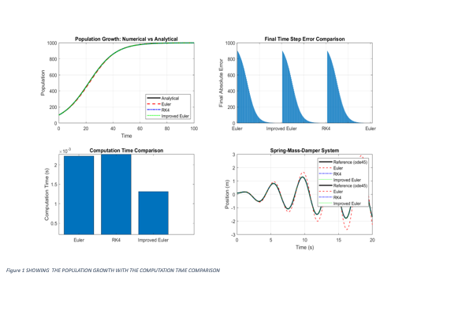

Slide 17
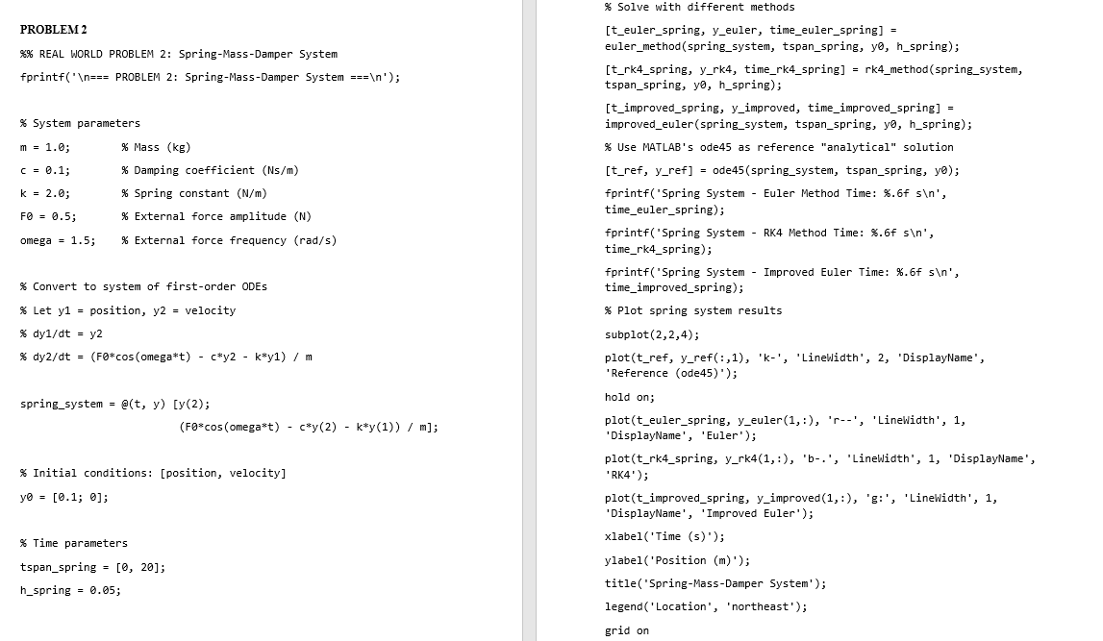

Slide 18
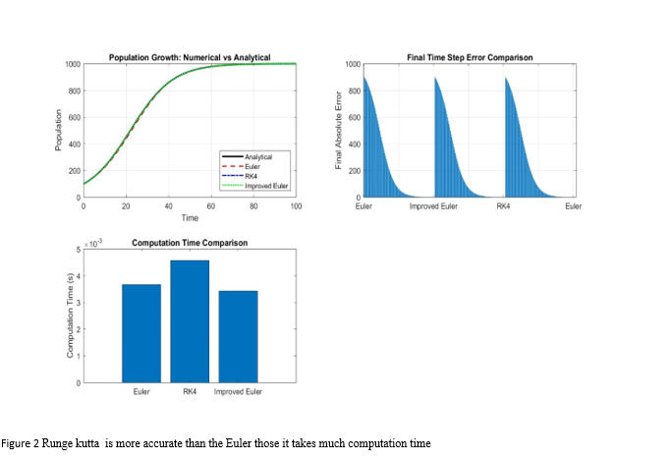

Slide 19
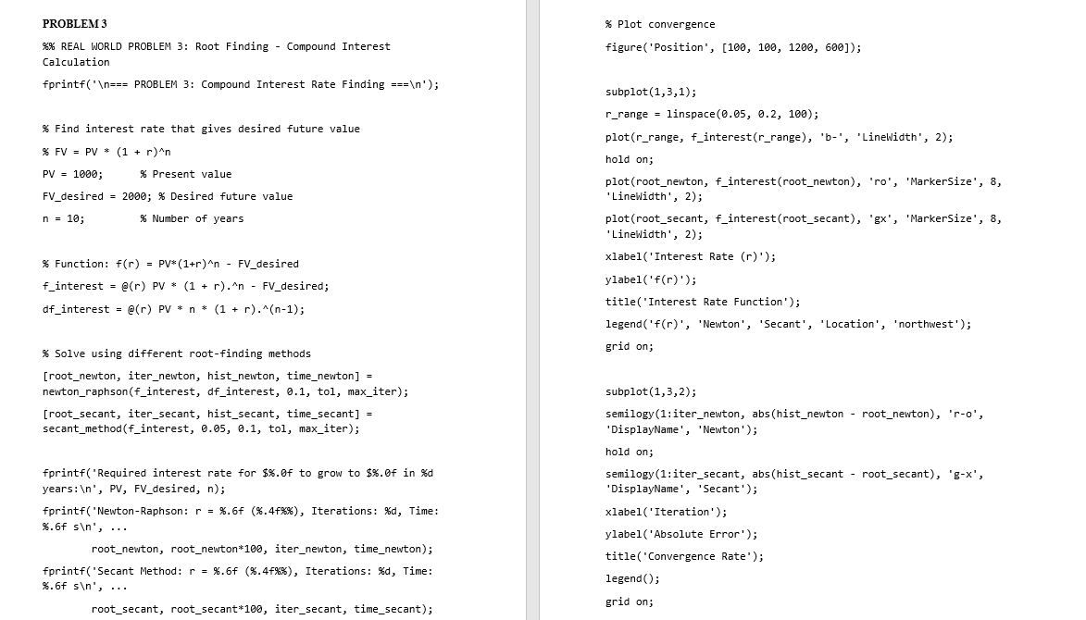

Slide 20
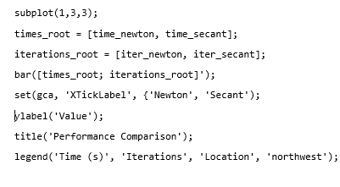

Slide 21
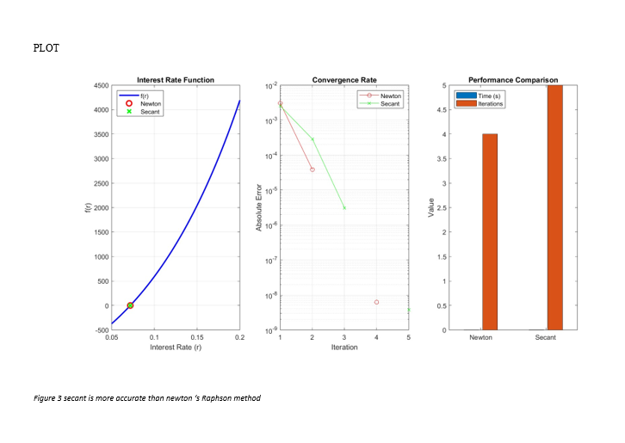

Slide 22
conclusion
Numerical methods in MATLAB provide powerful tools for solving complex mathematical problems that cannot be addressed analytically to problems such as non-linear equations, differential equations, and optimization tasks. These methods are essential for tackling real-world challenges in engineering, physics, and other scientific fields.

Slide 23
RECOMMENDATION
Clearly define the mathematical model and its constraints.
Select an appropriate numerical method (e.g., Newton-Raphson, finite difference) based on the problem type.
Always verify the accuracy of results by comparing with known solutions or conducting sensitivity analyses.

